Slide 1

Watson Studio

Slide 2
Objectives
Define the Watson Studio.
Explain how Watson Studio can streamline data projects and make them easier to manage.
List some of the primary assets included in Watson Studio.
Create a project in Watson Studio.
Watson Studio

Slide 3
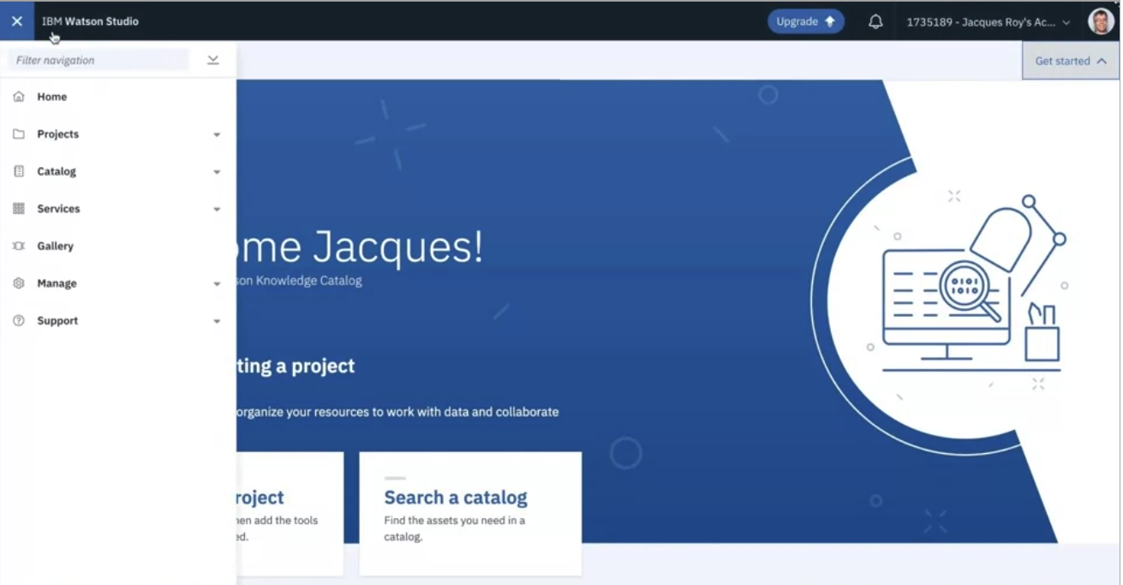
Watson Studio Introduction
Watson Studio is an integrated platform of tools, services, and data that helps companies accelerate their shift to become data-driven organizations.
Watson Studio was built as a collaborative platform a community
Watson Studio

Slide 4
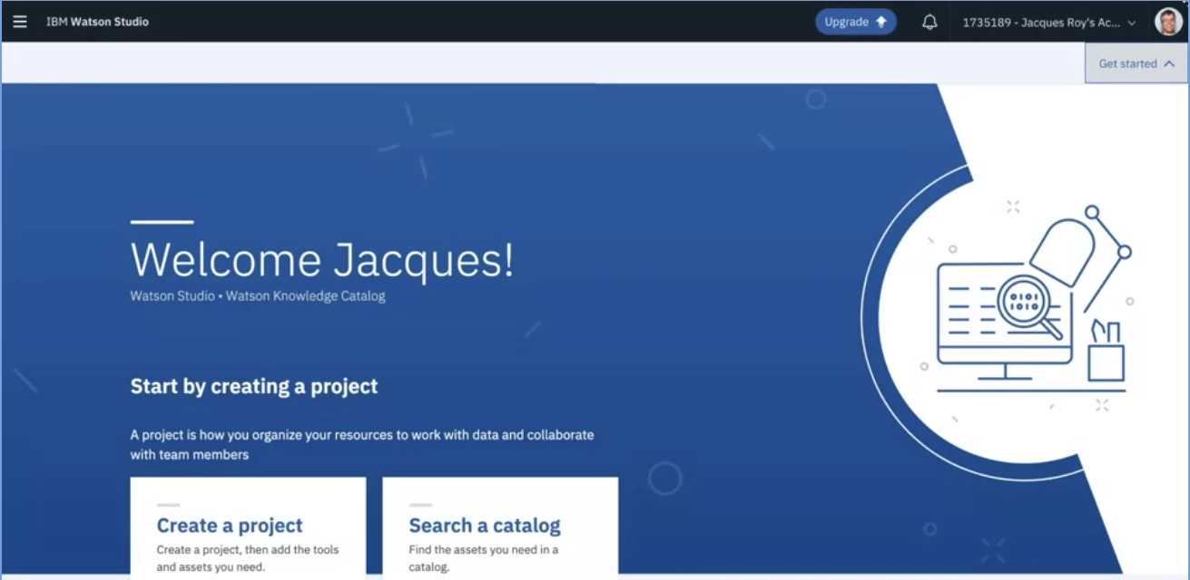
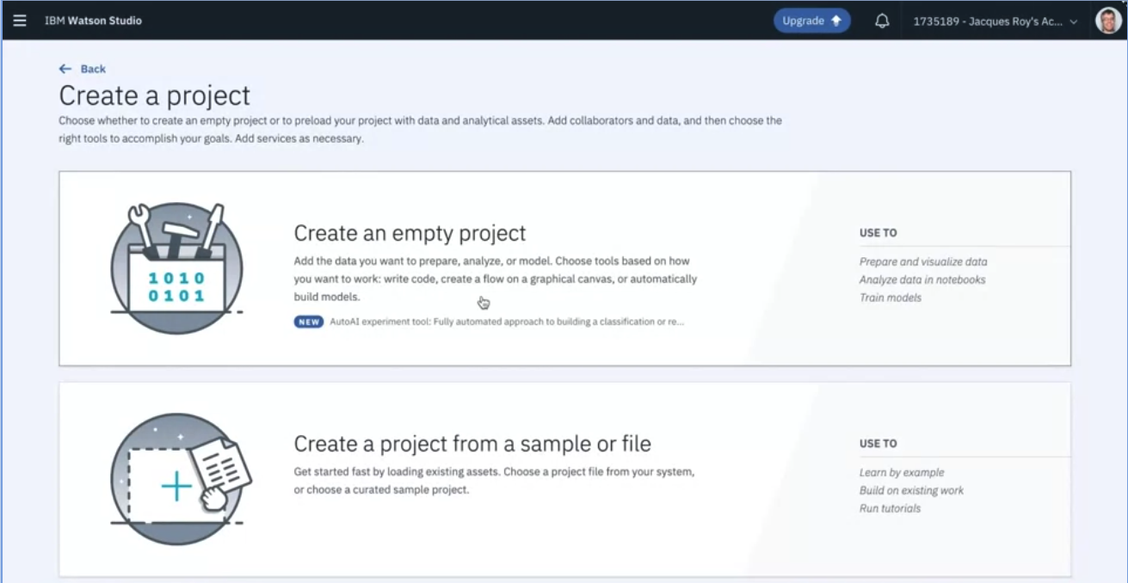
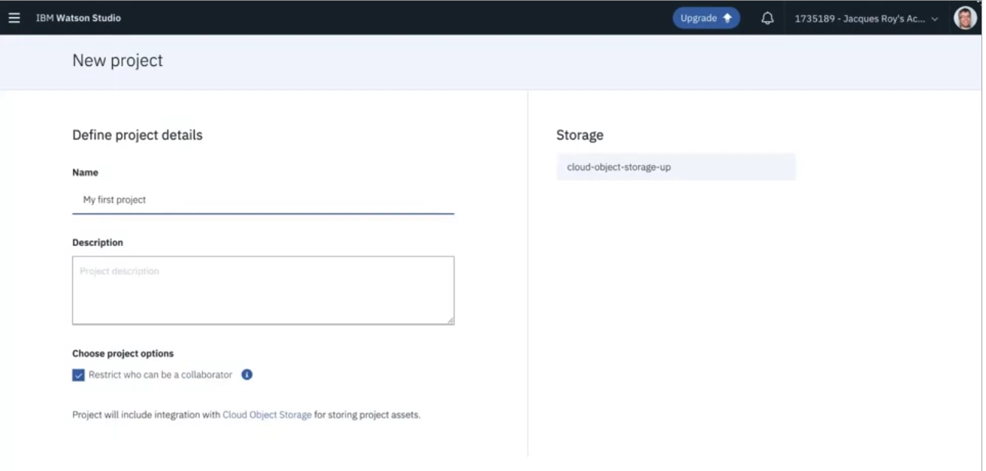
Create a project
2
1
3
Watson Studio

Slide 5
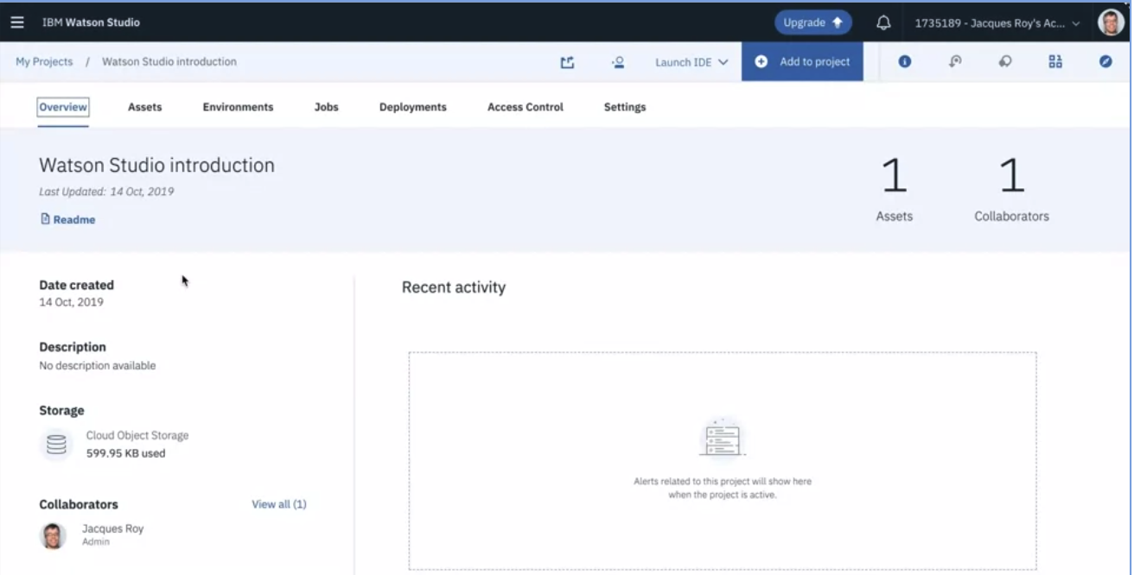
Created a project
Overview tab where you can see basic information on the project.
Watson Studio

Slide 6
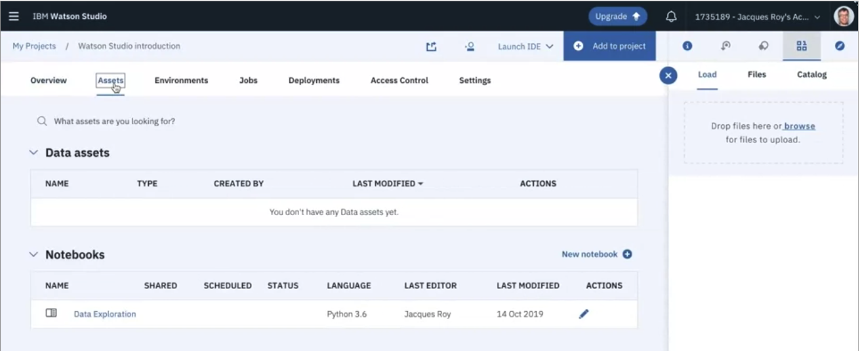
Created a project
Assets tab where you can see the data assets,models, notebooks, and other assets that are part of the project
Watson Studio

Slide 7
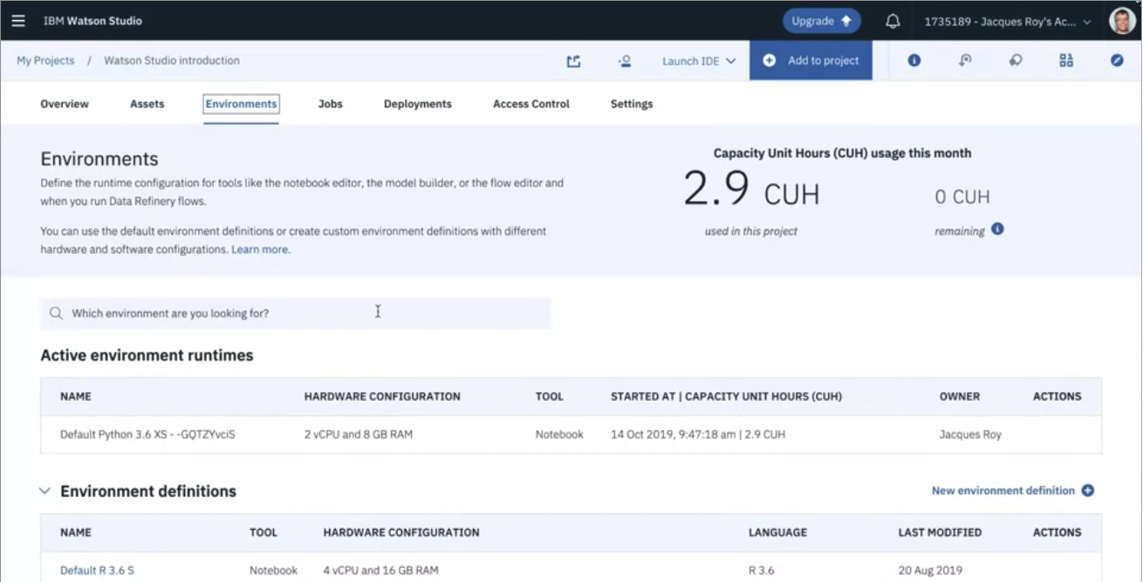
Created a project
Environment tab for exploration, data manipulation, and model creation is the notebook.
Watson Studio

Slide 8
Watson Studio Account
IBM Watson gives you access to IBM Watson Studio, IBM Watson Knowledge
Catalog, the data refinery, machine and deep learning, visual recognition models, dashboards and streams flows.
At https://dataplatform.cloud.ibm.com/ you can sign up for a free trial. When you sign up for an IBM Watson account you are automatically signed up for a free IBM Cloud account.
Watson Studio

Slide 9
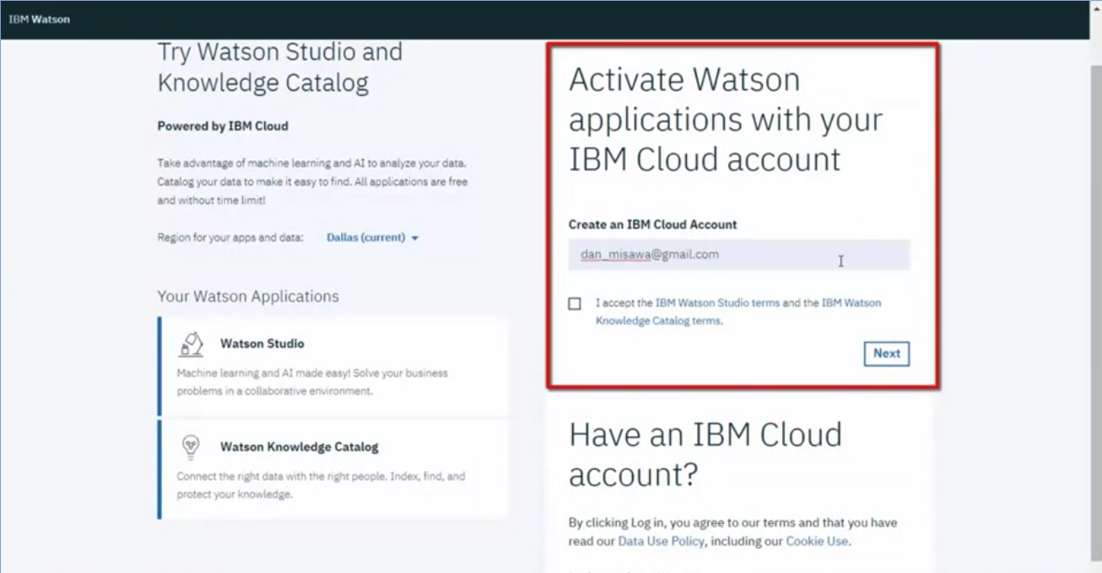
Watson Studio Account
Create an IBM cloud account
Watson Studio

Slide 10
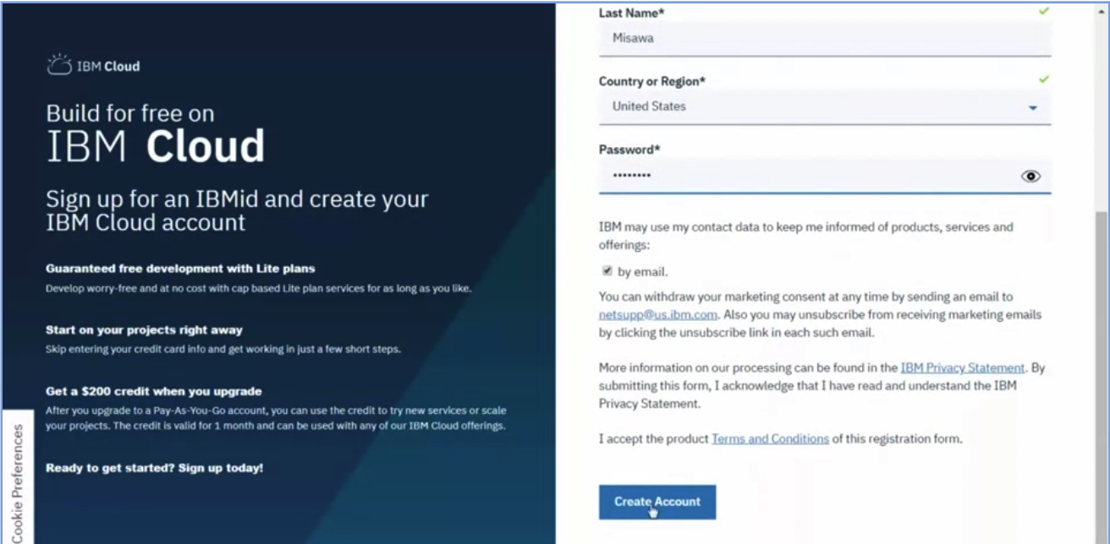
Watson Studio Account
Input basic information
Watson Studio

Slide 11
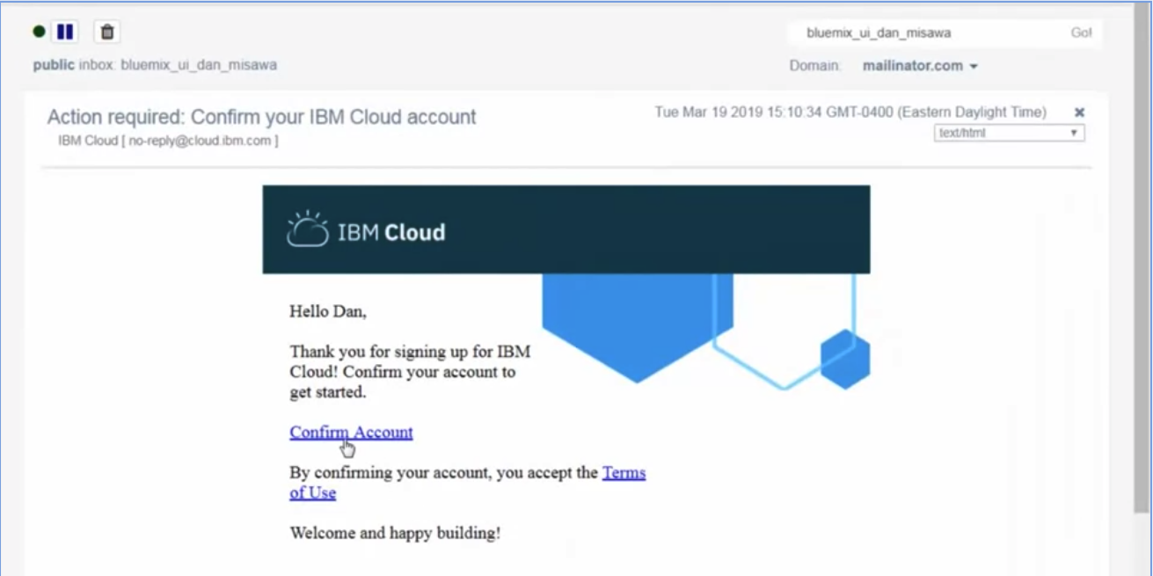
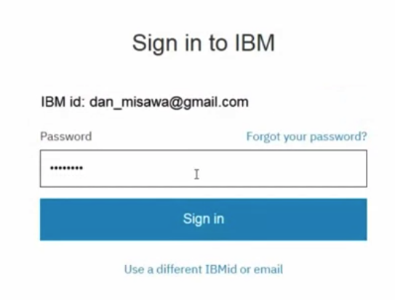
Watson Studio Account
Check your email, confirm and sign in to IBM
Watson Studio

Slide 12
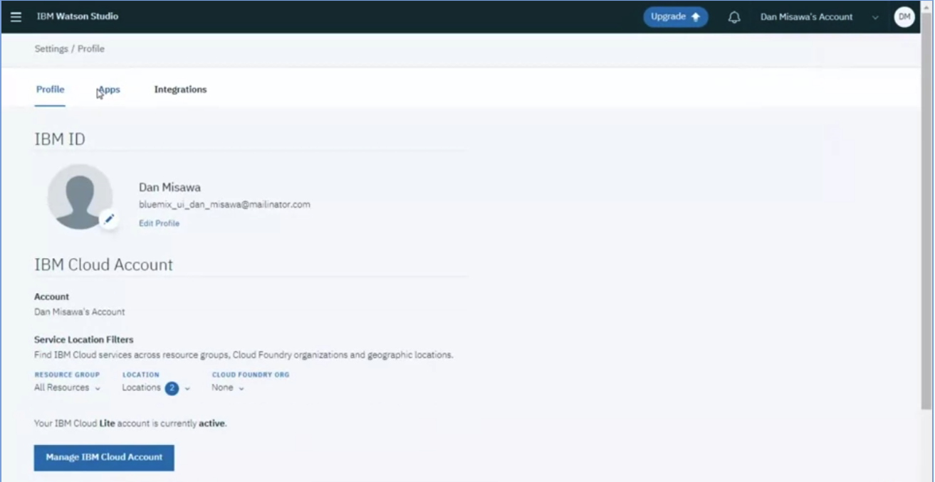
Watson Studio Account
View the settings to verify the applications and services that are provisioned.
Watson Studio

Slide 13
Summary
Define the Watson Studio.
Explain how Watson Studio can streamline data projects and make them easier to manage.
List some of the primary assets included in Watson Studio.
Create a project in Watson Studio.
Watson Studio

Slide 14
Q & A
Watson Studio

